Slide 1
D-310 Unit 6: Aircraft

Slide 2
Objectives
Students will be able to:
Describe the interaction of the Expanded Dispatch Support Dispatcher (EDSD) as it relates to the aircraft function.
Identify the difference between tactical and logistical missions.
Identify the different types of logistical aircraft requests.
Effectively utilize flight planning forms and methods.

Slide 3

Incident Position Standards Alignment
This unit aligns with the following EDSD Incident Position Standards located at
https://www.nwcg.gov/positions/expanded-dispatch-support-dispatcher/standards-and-references.
EDSD responsibility alignment
Perform effectively in each of the four functional areas.
Establish and maintain communication with frequent contacts, regulations, and response capabilities.

Slide 4

EDSD Flight Planning Responsibilities
Giving and receiving information about mobilization and demobilization of resources using aircraft.
Notes:
FS_ChelanComplex_015 | Helitack crewmembers at the Chelan Co… | Flickr

Slide 5
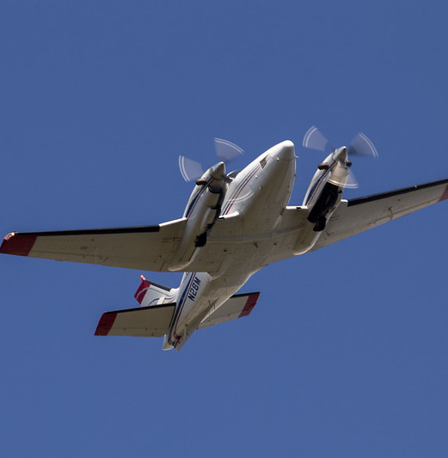
Flight Types (1 of 2)
Logistical flights
Also referred to as point-to-point or administrative.
Example
Transporting personnel and/or cargo.
Notes:
Airtankers Provide Aerial Support on the Pioneer Fire | Flickr

Slide 6

Flight Types (2 of 2)
Tactical flights
Also referred to as mission flights.
Require work in the air or a combination of ground and aerial work.
Example
Retardant application
Notes:
Airtankers Provide Aerial Support on the Pioneer Fire | Flickr

Slide 7
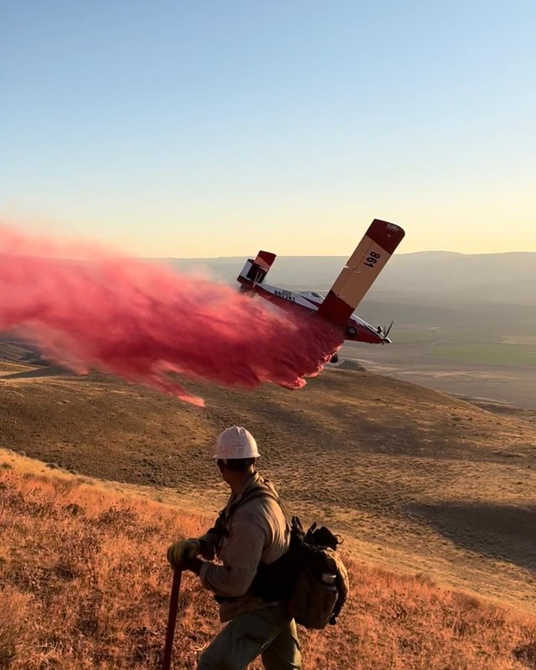
Aircraft Types
Helicopters
Type 1
Type 2
Type 3
Fixed-wing aircraft
Airtanker
Single Engine Airtanker (SEAT)
Lead plane
Other
Infrared (IR) requests
Frequencies
Temporary Flight Restrictions (TFRs)
Notes:
Elko Helitack | An Elko Helitack crewmember watches a single… | Flickr

Slide 8
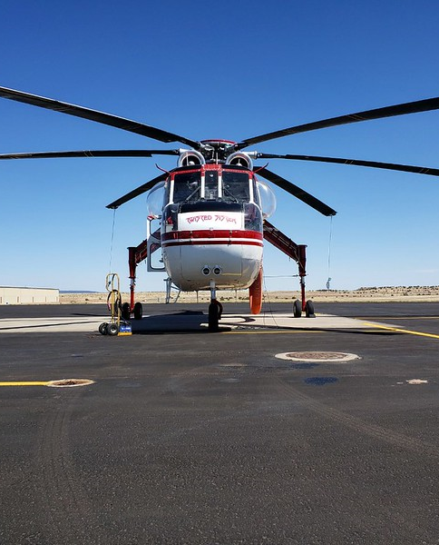
Aviation Management: NICC
Examples of NICC resources
Large transport aircraft
National lead planes and aerial supervision modules (ASM)
Smokejumper aircraft
Large and Very Large Airtankers
Type 3 multi-engine water scooper
Type 1 and Type 2 helicopters
Modular Airborne Fire Fighting Systems (MAFFS)
Military aircraft
IR aircraft
Frequencies
Notes:
BLM Photo Contest 2020: Aviation | 2020 BLM Fire and Aviatio… | Flickr

Slide 9
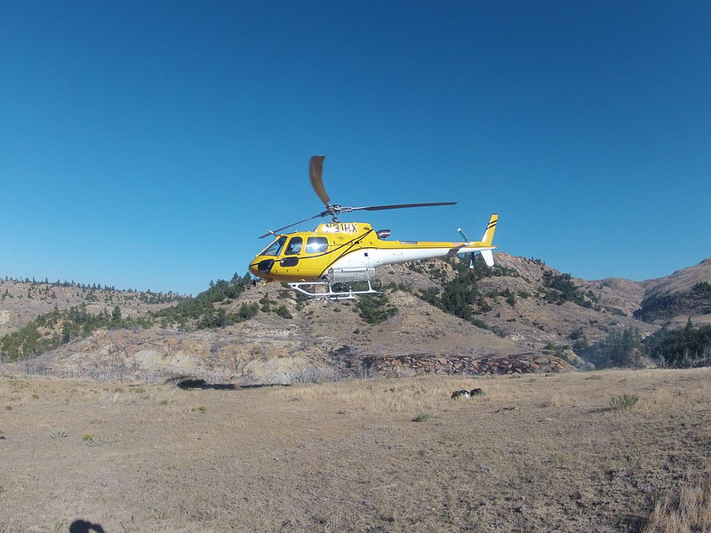
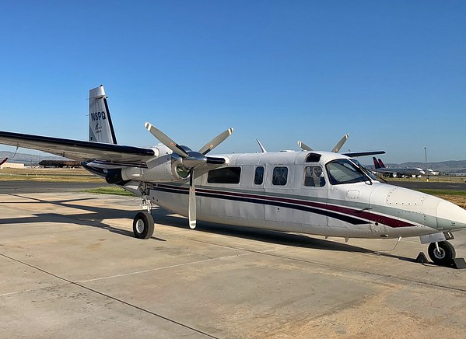
Aviation Management: Geographic Area Coordination Center (GACC) and/or Local
Examples of GACC resources
TFRs
Single engine air tankers (SEATs)
Logistical aircraft
Aircraft frequencies
Fixed-wing aircraft
Examples of local resources
Fixed-wing aircraft
Rotor-wing aircraft
TFRs
Notes:
Helicopter firefighting operations | Type 3 helicopter takin… | Flickr
Air Attack 12 | Air Attack 12 climbs extremely fast and can … | Flickr

Slide 10

Interaction Between Aircraft and Other Functional Areas
Expanded dispatch may order resources to support aircraft.
Expanded dispatch may request a logistical flight.
Communication with all functional areas is an essential part of a successful expanded dispatch operation.
Notes:
2022 BLM Fire Employee Photo Contest Category Aviation | Flickr

Slide 11
Crews
Transportation to and from the airport.
Coordinating with the mobilization center.
Specific drop off and pickup points.
Emergency release of crew member.
Tool transport (saws, etc.)

Slide 12
Overhead
Helicopter modules
Incident Management Team (IMT) support
Emergency release
Miscellaneous aviation support (e.g. security, Ramp Manager [RAMP])

Slide 13
Supply
Helibase support
Portable toilets
Trailers
Air attack kit
Fuel tender
Portable retardant plants
Transport of supplies

Slide 14

Aircraft Flight Request/Flight Schedule (1 of 6)
Considerations for flight planning
Safety
The right resource for the job
Cost effectiveness

Slide 15
Aircraft Flight Request/Flight Schedule (2 of 6)
The flight plan:
Identifies elements of the flight, including passengers and cargo.
Identifies hazard and safety information.
Provides a format to track the flight.

Slide 16
Aircraft Flight Request/Flight Schedule (3 of 6)
Initial Request Information block
Passenger and Cargo Information block
Flight Itinerary block
The EDSD will gather information to assist the Aircraft Dispatcher (ACDP) or Initial Attack Dispatcher (IADP).

Slide 17
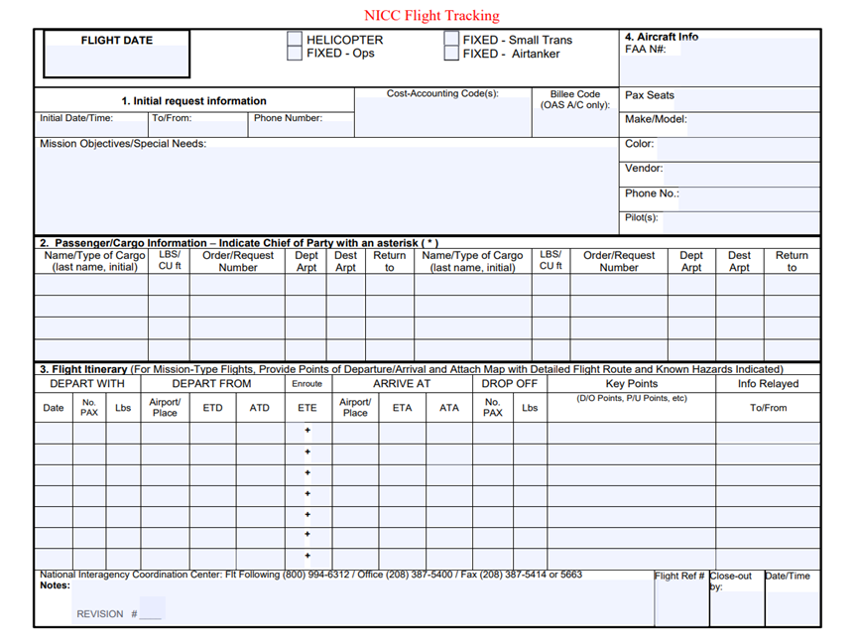
Aircraft Flight Request/Flight Schedule (4 of 6)
1. Initial Request Information block

Slide 18
Aircraft Flight Request/Flight Schedule (5 of 6)
2. Passenger and cargo information

Slide 19
Aircraft Flight Request/Flight Schedule (6 of 6)
3. Flight itinerary

Slide 20

Flight Tracking
The flight tracking information is critical in the event of an aircraft emergency.
Flight tracking is done by the local Initial Attack (IA) office. Occasionally, the EDSD has some responsibilities.
Notes:
Single Engine Airtanker | Single Engine Airtanker on a runwa… | Flickr

Slide 21

Interpret Flight Itinerary
A good source for airport identifiers: https://airnav.com/airports
Notes:
Single Engine Airtanker | Single Engine Airtanker preparing … | Flickr

Slide 22

Common Acronyms
ATA = Actual time of arrival
ATD = Actual time of departure
DPT = Departure airport
DST = Destination airport
ETA = Estimated time of arrival
ETD = Estimated time of departure
ETE = Estimated time en route

Slide 23
Times
Times should always reflect the local time zone.
ETD GEG 08:00P
ETA BOI 11:00M
GEG=Spokane, WA=Pacific Time
BOI=Boise, ID =Mountain Time

Slide 24
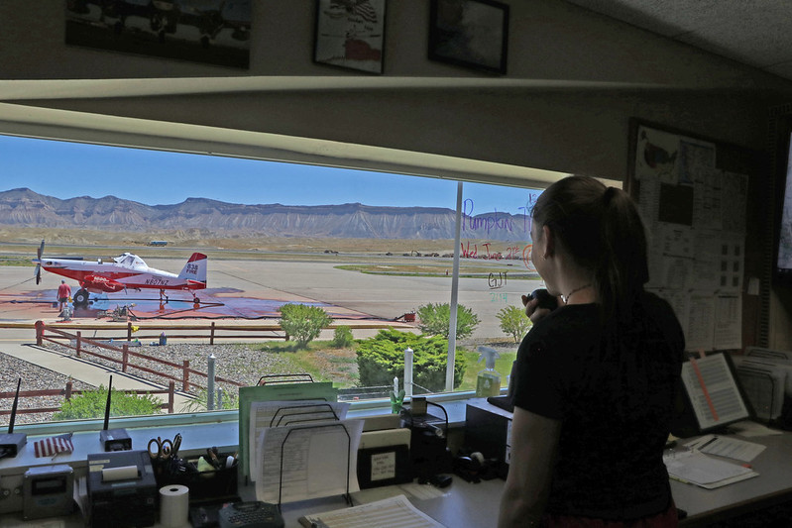
Flight Manager Responsibilities
The Flight Manager is a designated representative in charge of flight operations including:
Passenger safety
Flight invoice
Establish flight following procedures
Notes:
Grand Junction Airtanker Base 38 | Support personnel at the … | Flickr

Slide 25

Activity: Flight Planning
Notes:
Airtankers Drop Retardant on the Happy Camp Complex | Flickr

Slide 26
Summary
The EDSD is responsible for determining the flight passengers/cargo, destinations, and time frames, then passing that information to the ACDP. The EDSD also gives and receives information about the mobilization and demobilization of resources using aircraft.
Logistical flights fly directly between airports/helibases; tactical (mission) flights require a combination of ground and aerial work.
Each dispatch level (e.g., NICC, GACC, local) handles different types of aviation resources.
EDSDs communicate with Crews, Overhead, and Supply regarding aircraft mobilization.
The Aircraft Flight Request/Flight Schedule form is completed prior to every logistical aircraft flight.
The EDSD may have some responsibilities related to flight tracking.

